Slide 1
Topology Awareness for Distributed Version Control Systems
Cristiano Cesário, Leonardo Murta
{ccesario, leomurta}@ic.uff.br
DyeVC is available at github.com/gems-uff/dyevc

Slide 2
Summary
Introduction
DyeVC: Overview
Evaluation
Conclusion

Slide 3
Centralized x Distributed repositories
1. Introduction
Workspace
Repository
Repository
clone / pull
check-out / update
commit
push
Repository
check-out / update
Workspace
commit
Workspace
Centralized Repository
Distributed Repository

Slide 4
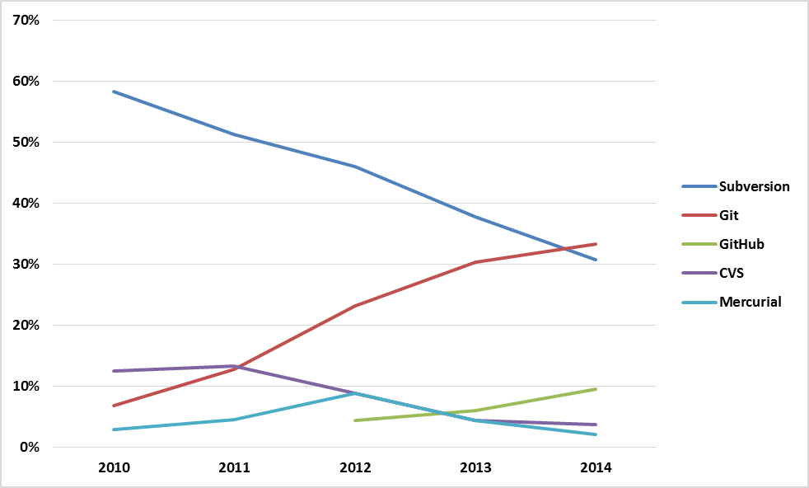
Increasing DVCS usage
1. Introduction
Fonte: Eclipse Foundation. The Open Source Developer Report - 2014 Eclipse Community Survey.
Notes:
Promoted on the eclipse.org homepage, Twitter, Facebook, and Google +
1069 individual responses were received and 876 completed the survey
Principais CVCS vs DVCS:
2010: 70% vs 10%
2011: 60% vs 18%
2012: 55% vs 31%
2013: 45% vs 45%
2014: 35% vs 48%

Slide 5
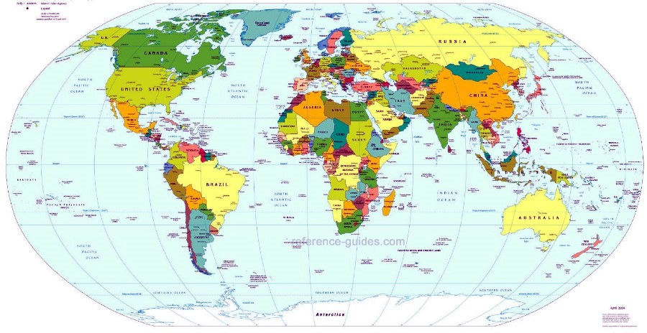
Globalization
1. Introduction
Distributed Software Development
Risk factors[Battin et al. 2001]
Notes:
Risk Factors:
Physical distance
Time zone disparity
Domain expertise
Architecture
Software integration
Software conf. mngt.
Vendor support
Governmental issues
Development process
Local impression of remote terms

Slide 6
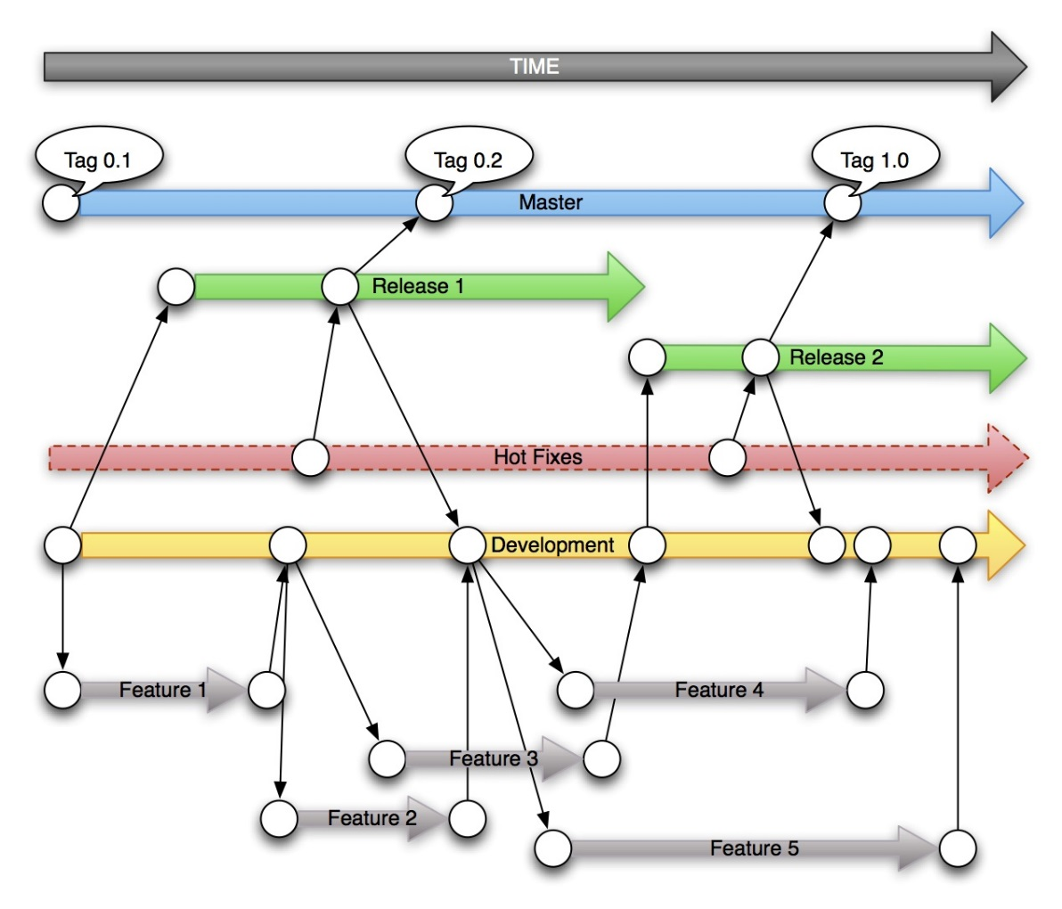
Branches proliferation
1. Introduction
Clone creation
push and pull
Tracking
Anonymous branches
Notes:
Proliferação de ramos

Slide 7



Example
1. Introduction
Xavier Institute
Wolverine
Gambit
Professor Xavier
Rogue
Nightcrawler
Cyclops
Jean Gray
Mystique
Push
Beast
Pull

Slide 8
Awareness in distributed repositories
1. Introduction
Q1: Which clones were created from a repository?
Q2: What are the dependencies between different clones?
Q3: Which changes are under work in parallel and which of them are available to be incorporated into my work?
Q4: Is it computationally feasible to gather this information from all known repository clones, keeping them available to be used when needed?

Slide 9
Goals
1. Introduction
Provide topology awareness among related repositories in a unobtrusive way
Via notifications
Visualize dependencies among repositories of a given project
Topology
Different levels of detail

Slide 10
Summary
Introduction
DyeVC: Overview
Evaluation
Conclusion

Slide 11
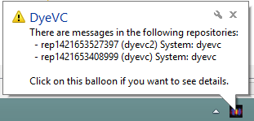






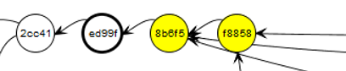
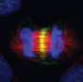
Architecture
2. DyeVC*: Overview
DyeVC Database
rep
rep
rep
rep’
rep’
rep’
DyeVC App
DyeVC App
DyeVC App
* DyeVC stands for Dye over Version Control

Slide 12

Levels of detail
2. DyeVC: Overview
Level 1: Notifications
Level 2: Topology
Level 3: Branches
Level 4: Commits

Slide 13
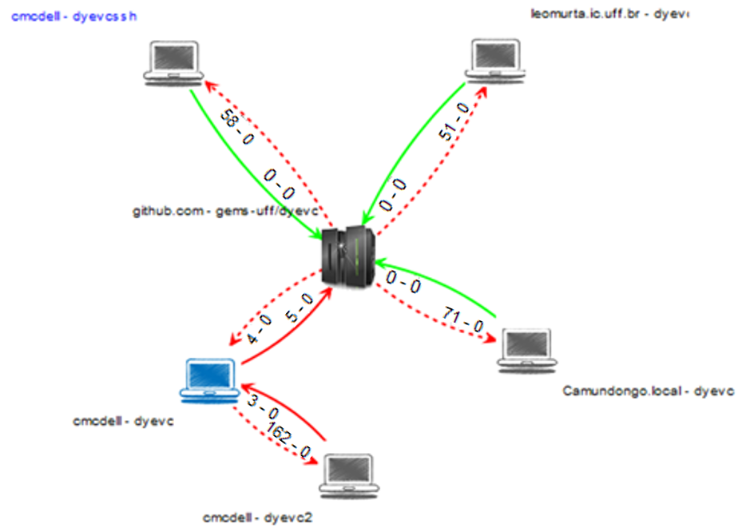
Level 2: Topology
2. DyeVC: Overview
Partner
Central repository
My repository

Slide 14
Level 2: Topology
2. DyeVC: Overview
Commits in non-tracked branches
Commits in tracked branches
Push, synchronized
Push, non-synchronized
Pull, synchronized
Pull, non-synchronized

Slide 15
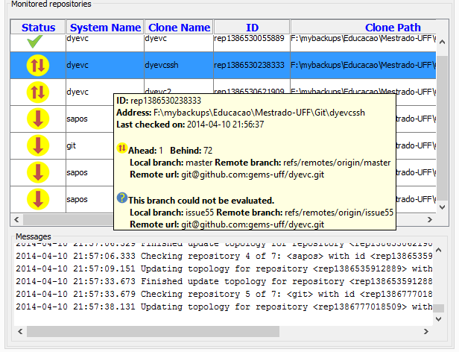
Level 3: Branches
2. DyeVC: Overview

Slide 16
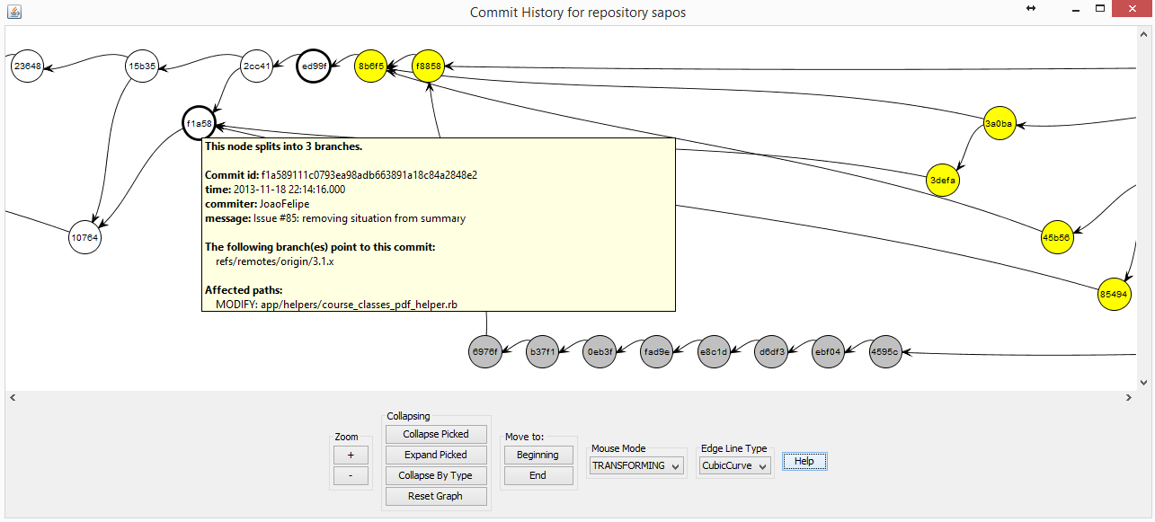
Level 4: Commits
2. DyeVC: Overview

Slide 17
Level 4: Commits
2. DyeVC: Overview

Slide 18
Summary
Introduction
DyeVC: Overview
Evaluation
Conclusion

Slide 19
Performed evaluations
3. Evaluation
Post-hoc analysis
Observational study
Performance evaluation

Slide 20

Post-hoc analysis
3. Evaluation
Available at GitHub*
Repository history reconstructed
Began in 2006
6,222 commits
*github.com/jquery/jquery

Slide 21
Post-hoc analysis
3. Evaluation
Answered questions
Q1: Which clones were created from a repository?
Q2: What are the dependencies between different clones?

Slide 22
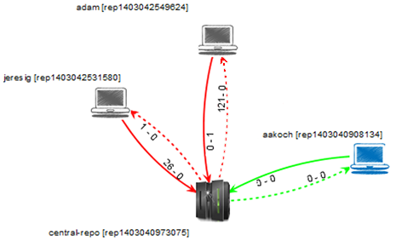
Post-hoc analysis
3. Evaluation
Topology View (L2)

Slide 23
Post-hoc analysis
3. Evaluation
Answered questions
Q3: Which changes are under work in parallel and which of them are available to be incorporated into my work?

Slide 24
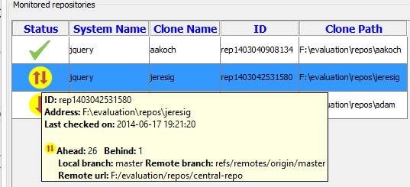
Post-hoc analysis
3. Evaluation
Branches View (L3)

Slide 25
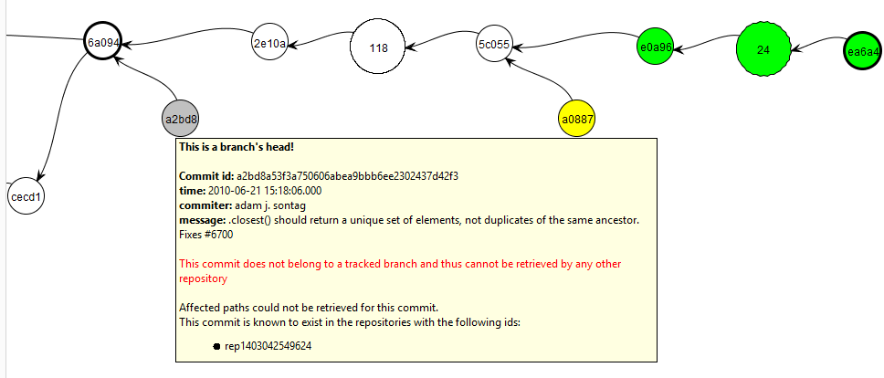
Post-hoc analysis
3. Evaluation
Commits View (L4)

Slide 26
Observational study
3. Evaluation
Goal
To analyze when DyeVC helps on understanding the project history better than existing tools
Participants
Four volunteers

Slide 27


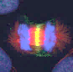

Observational study
3. Evaluation
Scenario 1
Phase 1
Phase 2
Scenario 2

Slide 28
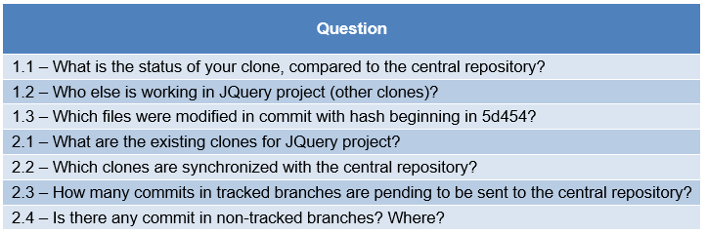
Observational study
3. Evaluation
Posed questions
Notes:
1.x: Questions for the Developer Scenario
2.x: Questions for the Repository Administrator Scenario

Slide 29
Observational study
3. Evaluation
Observations:
Procedure used to answer questions in Phase 1
Which questions in Phase 1 could not be answered
Which questions not answered in Phase 1 were answered in Phase 2
General approach evaluation

Slide 30
Observational study
3. Evaluation
Comments from participants
“It helps visualizing peers and their relationships”
“It helps visualizing the status of each clone”
“It let us view non-tracked branches and commits in all the topology, regardless of clones where they can be found”

Slide 31
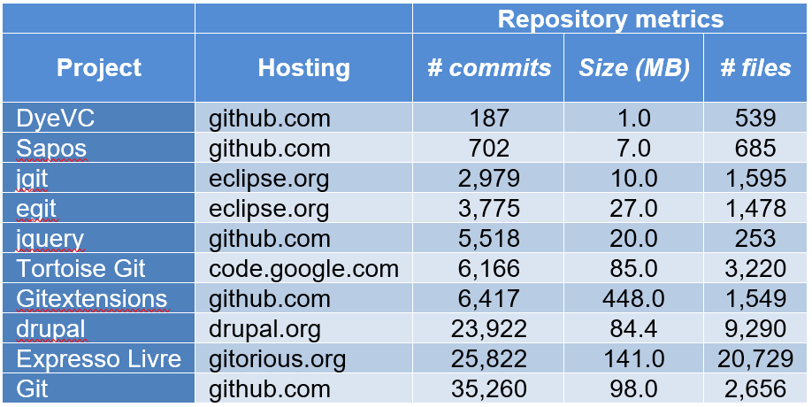
Performance evaluation
3. Evaluation
Q4: Is it computationally feasible to gather this information from all known repository clones, keeping them available to be used when needed?
Open-source repositories

Slide 32
Performance evaluation
3. Evaluation

Slide 33
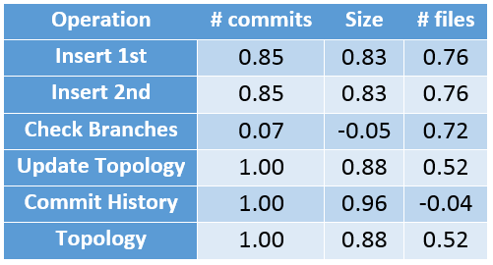
Performance evaluation
3. Evaluation
Spearman’s rank correlation coefficient

Slide 34
Threats to validity
3. Evaluation
Post-hoc analysis
Multiple possible sequences of events
Number of projects
Open source project
Observational study
Participants selection
Tasks execution
Performance evaluation
Instrumentation
Notes:
Multiple possible sequences
Number of projects: limitations from a statistical standpoint
Instrumentation (database over internet, home network usage)
Open source project: modus operand may be different from that of academic / corporate contexts
Participants selection: volunteers, may be biased, few number
Tasks execution: tasks involving DyeVC performed right after presenting the approach

Slide 35
Summary
Introduction
DyeVC: Overview
Evaluation
Conclusion

Slide 36
Major contributions
4. Conclusion
Monitoring and topology awareness in DVCS
Visualizing dependencies among clones
Non obtrusive information gathering
Visualizing different levels of detail

Slide 37
Future work
4. Conclusion
Automatically grouping commits (level 4 visualization)
Optimizations for enhancing scalability
Gathering more metadata
Gathering diff’s for conflicts visualization
Data mining from gathered information
Metrics visualization

Slide 38
Topology Awareness for Distributed Version Control Systems
Thank You!
Cristiano Cesário, Leonardo Murta
{ccesario, leomurta}@ic.uff.br
DyeVC is available at github.com/gems-uff/dyevc

Slide 39
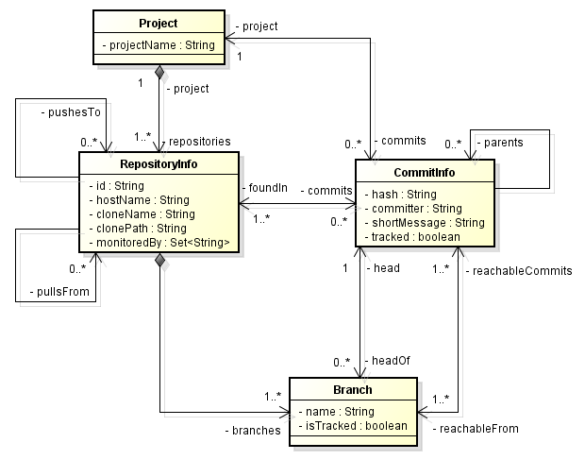
Gathered information*
2. DyeVC: Overview

Slide 40
Level 2: Topology*
2. DyeVC: Overview
Topology Discovery
3
2
4
8
1
5
7
6

Slide 41
Level 2: Topology
2. DyeVC: Overview
Topology Discovery
3
2
4
8
1
5
7
6

Slide 42
Level 2: Topology
2. DyeVC: Overview
Topology Discovery
3
2
4
8
1
5
7
6

Slide 43
Level 2: Topology
2. DyeVC: Overview
Topology Discovery
3
2
4
8
1
5
7
6

Slide 44
Level 2: Topology
2. DyeVC: Overview
Topology Discovery
3
2
4
8
1
5
7
6

Slide 45
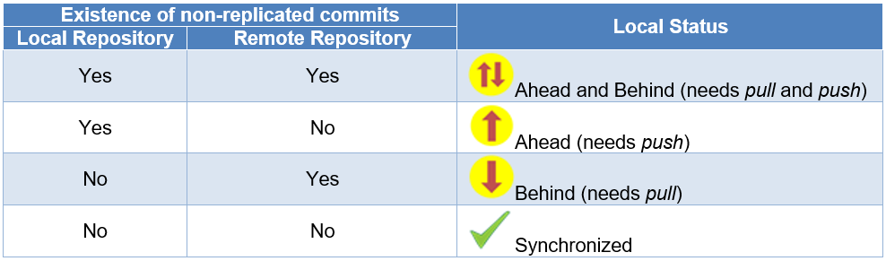
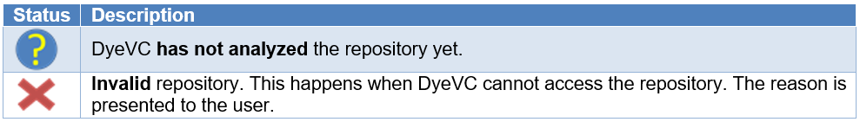
Level 3: Branches*
2. DyeVC: Overview

Slide 46
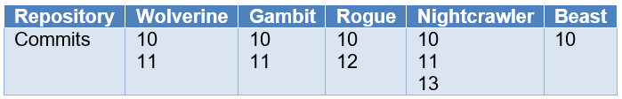
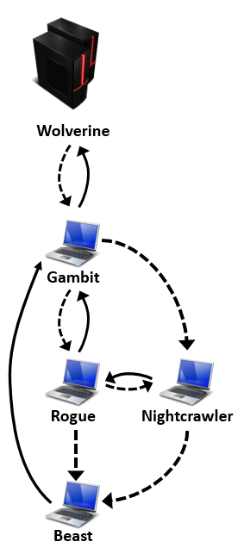
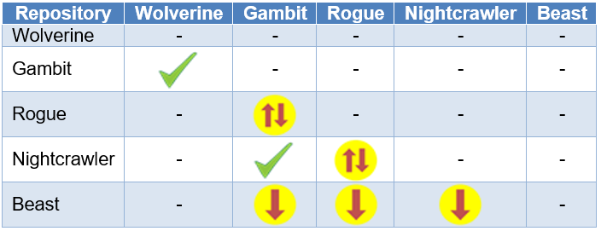
Level 3: Branches*
2. DyeVC: Overview

Slide 47
Level 4: Commits*
2. DyeVC: Overview
Where commit exists
Branches and tags
Everyone has it
Regular commit
Not pushed to all partners
Pointed by a branch
Not pulled
Pointed by a tag
Some non partner has it
Exists in a non-tracked branch

Slide 48
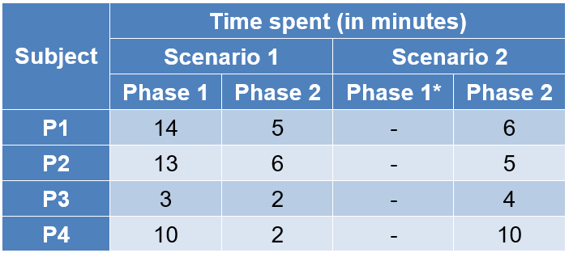
Observational study*
3. Evaluation
Time to complete each Scenario
* No participant could answer questions from Scenario 2 in Phase 1
Notes:
Falar sobre mudanças nas respostas, com e sem o uso do DyeVC

Slide 49
Performance evaluation*
3. Evaluation
Q4: Is it computationally feasible to gather this information from all known repository clones, keeping them available to be used when needed?
Answer
Information gathered from repositories with different sizes
RAM usage up to 1.5 GB
Presentation within reasonable time
Topology in up to 17 seconds
Tracking branches check in few seconds
Commit History limited to approximately 6.5k commits

Slide 50
Limitations*
4. Conclusion
Limited scalability
Restrictions in level 4 information (commits)
Need for a central database
Possibility to use a different database
Visualizing clones that are not used anymore

